Slide 1
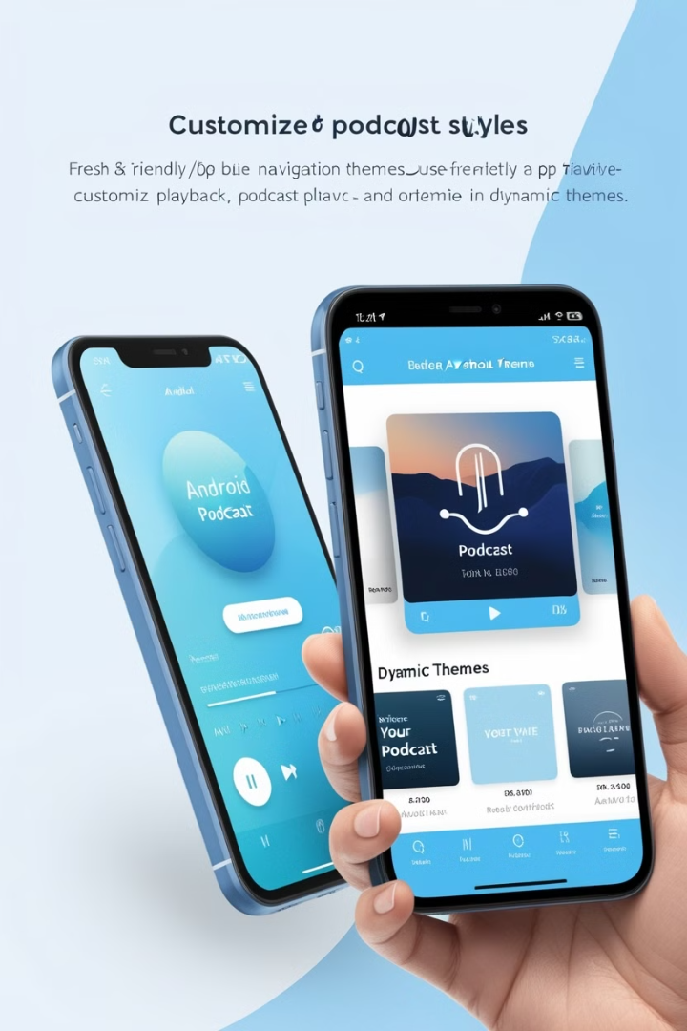
A Redox Inspired Podcast App With Dynamic Themes For Android
SUBMITTED BY:
F20C834AEC202CDA8CC48C03BEFFECOE - PUGAZHENTHI D
F4ED75CD735D5B886D144633F2680CBC - SUGANTHAN R
9D3139FBC8CE2D596894A95DC1F0D1AE - RAJASHREE D
D1D9C2D4BFB3A8493E440D2FF25BB817 - AMREEN R
FEE8697B66F9F4A89F64C13826418D51 - AKSHAYA S

Slide 2
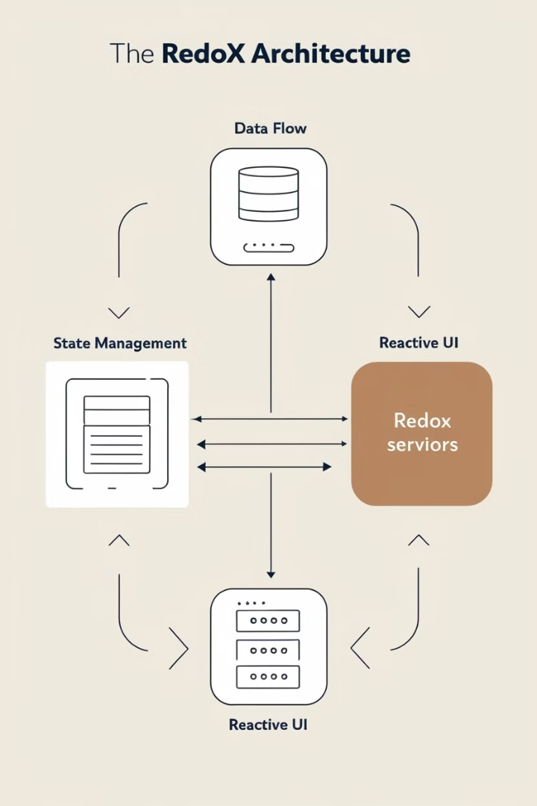
Introduction to Redox Architecture
Data Flow
State Management
Redox leverages unidirectional data flow for predictable and manageable state updates.
It utilizes a centralized state store for consistent data access across the app.
Reactive UI
The UI automatically updates in response to state changes, ensuring responsiveness.

Slide 3
Benefits of Redox for Mobile Apps
Improved Maintainability
Enhanced Testability
Enhanced Scalability
Redox's structured approach simplifies code management and reduces complexity.
Predictable state updates and clear separation of concerns make testing easier.
Redox's modular design allows for the efficient development of larger applications.

Slide 4

Designing Dynamic Themes
1
Theme Customization
2
Color Palettes
Utilize contrasting and complementary colors to enhance visual appeal and readability.
Allow users to choose from predefined themes or create personalized settings.
3
Typography
4
Visual Elements
Select appropriate font families and sizes for a consistent and readable user interface.
Consider icons, background images, and animations to complement the overall theme.

Slide 5
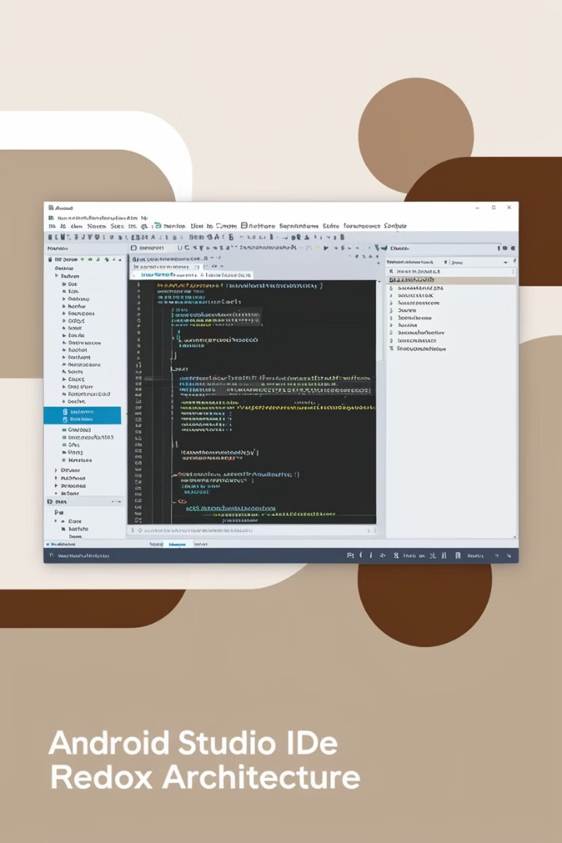
Implementing Redox in Android
1
Dependency Management
Integrate essential Redox libraries for state management and reactive UI.
2
State Store
Define the app's state and create a centralized store for data management.
3
Data Flow
Implement a unidirectional flow for state updates and UI rendering.
4
UI Components
Compose UI elements that react to state changes and provide interactive experiences.

Slide 6
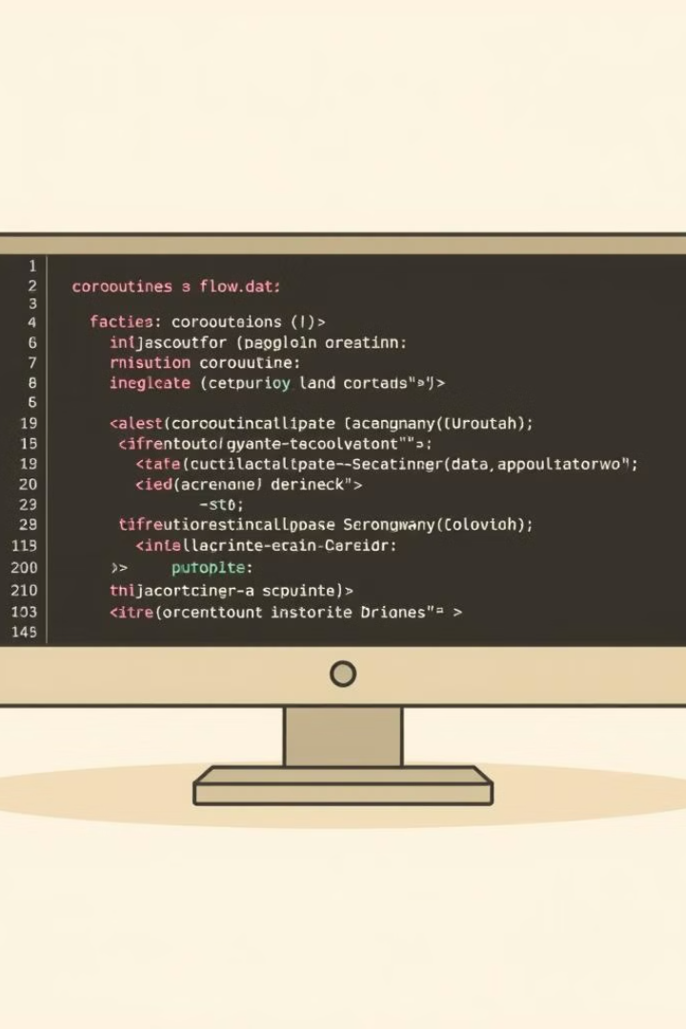



Leveraging Coroutines and Flows
Asynchronous Operations
Coroutines handle background tasks like network requests and database interactions.
Data Streams
Flows manage the flow of data from asynchronous sources, providing real-time updates.
State Updates
Integrate Flows with the state store to update the UI based on asynchronous data.

Slide 7




Reactive State Management
State Updates
State changes are propagated through the system, triggering UI updates.
UI Re-rendering
Components automatically re-render when their dependencies in the state change.
Data Flows
Data streams ensure that the state is updated with the latest information.

Slide 8
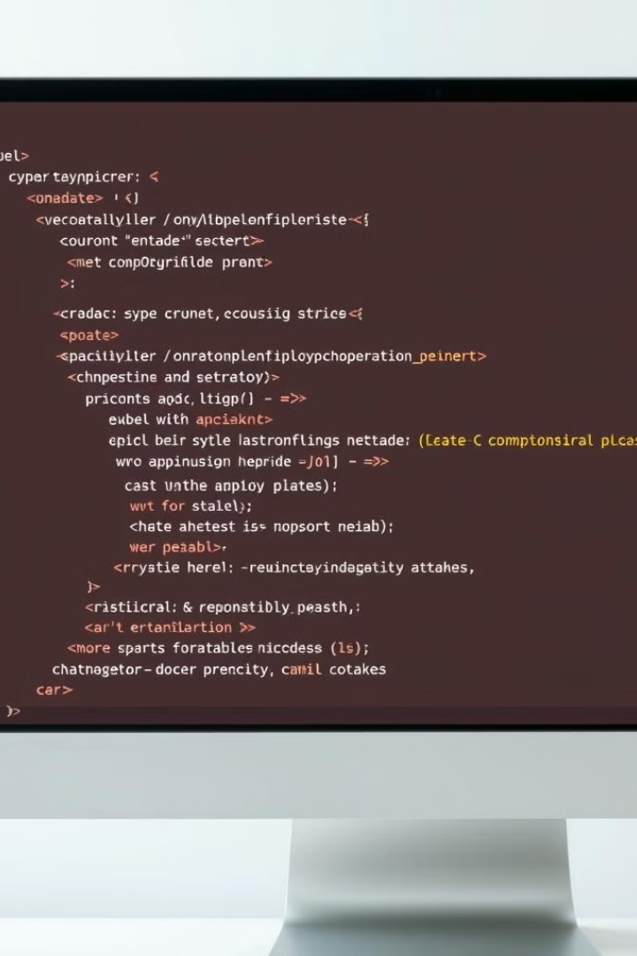
Declarative UI with Compose
Declarative
Focus on describing the UI's appearance and behavior, leaving the implementation to Compose.
Composable
Build the UI from reusable components, promoting code reusability and maintainability.
Reactive
Compose automatically updates the UI in response to state changes, ensuring responsiveness.

Slide 9
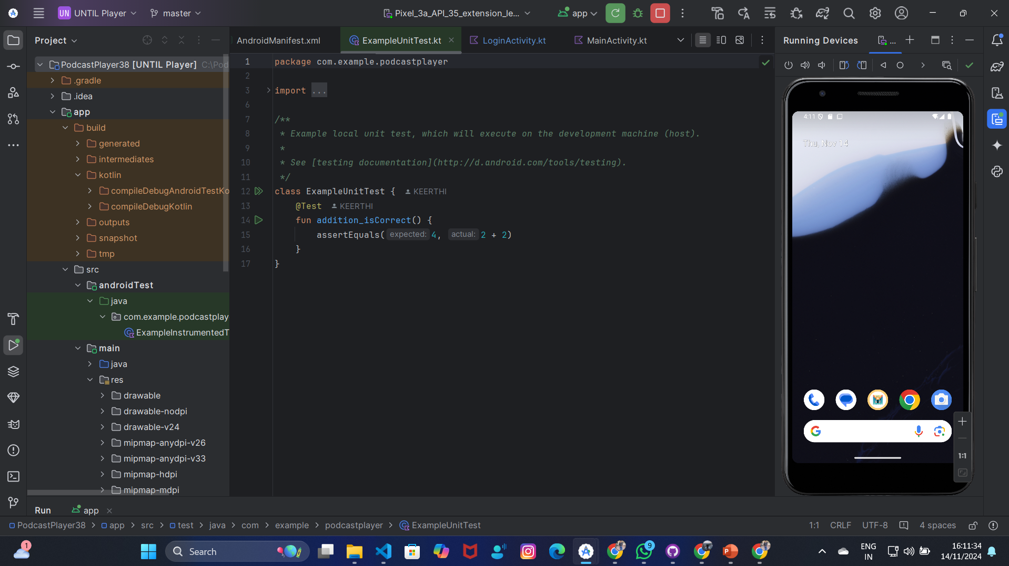

Slide 10


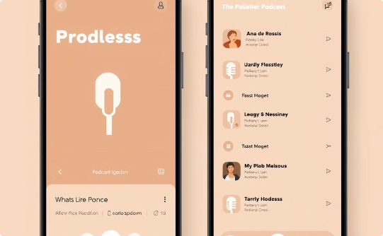
Adaptive Theme System
Dark Mode
Light Mode
Custom Themes
Reduces eye strain and improves battery life on AMOLED displays.
Provides a classic and familiar look and feel for users.
Allow users to personalize the app's appearance and reflect their preferences.

Slide 11
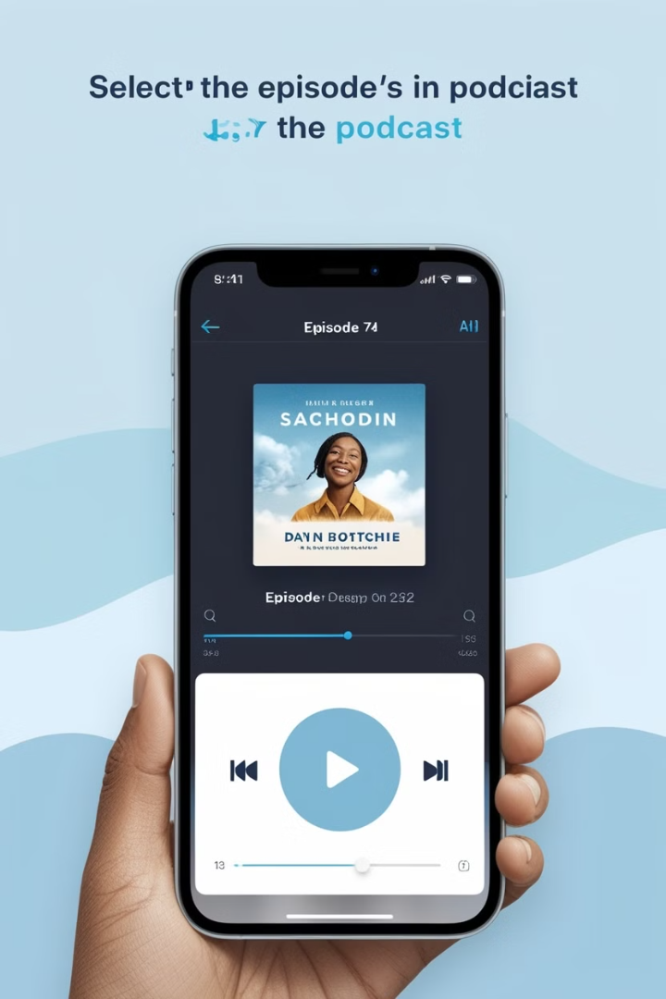
Extending the App with Plugins
1
Audio Player Extensions
Add support for different audio formats or streaming services.
2
Social Integration
Enable sharing of podcasts on social media platforms.
3
Personalized Recommendations
Implement algorithms to suggest podcasts based on user listening history.

Slide 12




Challenges of building podcast apps for Android
User Interface Complexity
Designing an intuitive UI that caters to diverse user needs is difficult.
Data Synchronization
Ensuring consistent playback across devices poses significant challenges.
Battery and Performance
Optimizing battery usage while maintaining smooth performance is essential.

Slide 13
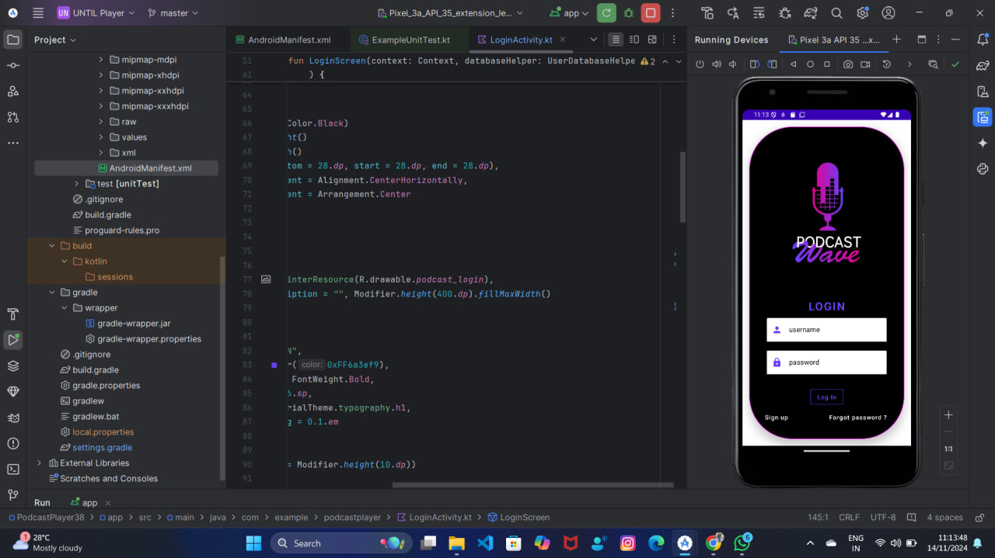

Slide 14
The Redox Inspired Architecture: Principles and Benefits
Core Principles
Key Benefits
State management
Improved reliability
Modular design
Enhanced maintainability
Scalable architecture
Greater flexibility

Slide 15


Dynamic Theming: Responsive Design and Personalization
Dark Mode
Light Mode
Offers a sleek look, preferred for night-time use and power saving.
Best for daylight use, providing clarity and comfort for users.

Slide 16

Podcast Playback and Offline Support
1
Seamless Streaming
High-quality continuous playback ensures a flawless listening experience.
2
Offline Mode
Download episodes for uninterrupted listening without internet.
3
Auto Sync
Syncs playback across devices for smooth transitions between sessions.

Slide 17
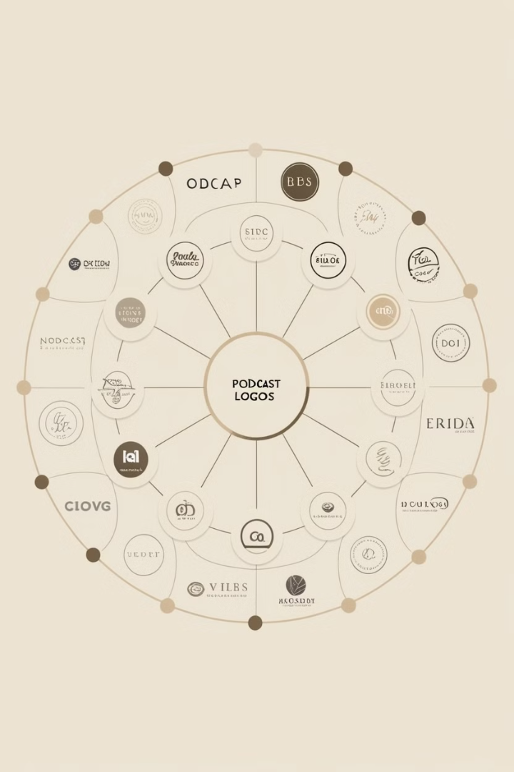



Seamless Integration with Existing Podcast Ecosystem
API Compatibility
Integrates easily with popular podcast services and directories.
Cross-Platform Support
Ensures compatibility with various smart devices and operating systems.
Automatic Updates
Fetches latest episodes and shows without user intervention.

Slide 18
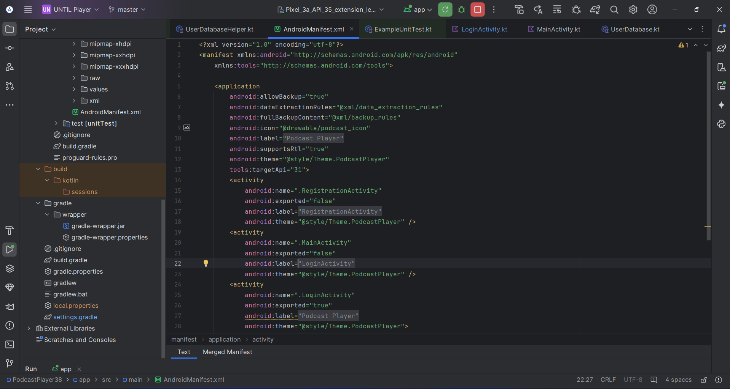

Slide 19
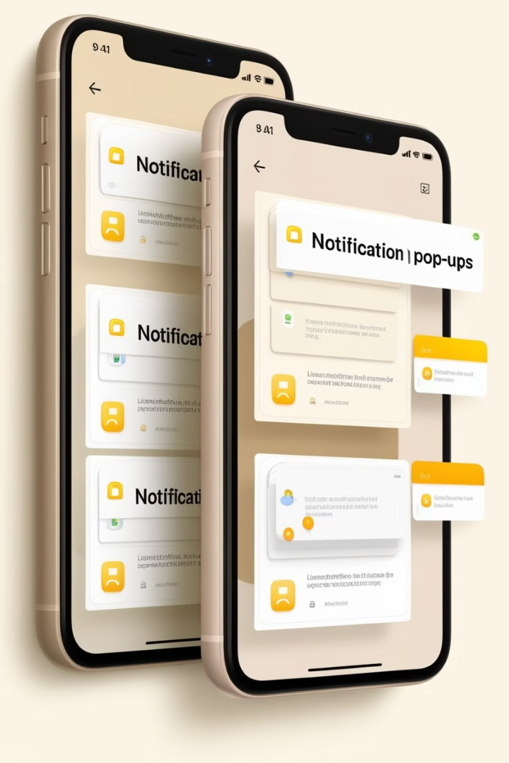



User Engagement Strategies: Notifications and Recommendations
Notifications
Stay updated with new episodes and live events through timely alerts.
Recommendations
Discover new content based on listening history and preferences.
User Preferences
Adjust settings for tailored podcast suggestions and better engagement.

Slide 20
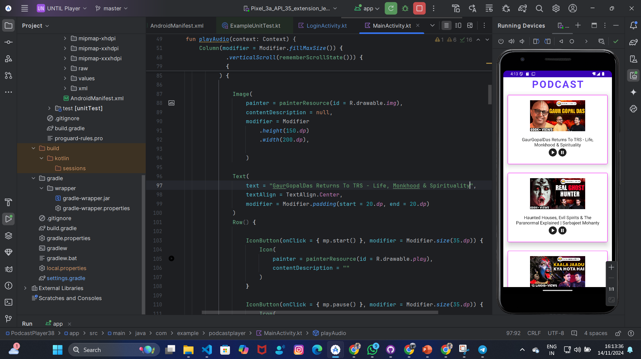

Slide 21
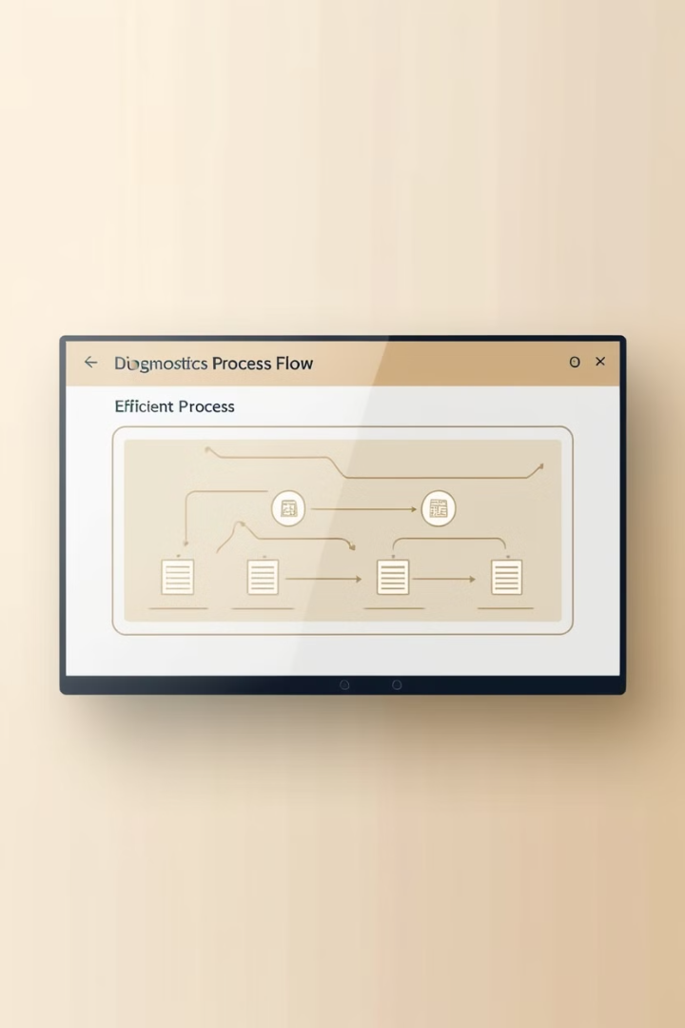
Performance Optimizations and Battery Efficiency
1
Efficient Code
2
Dynamic Caching
Optimized algorithms reduce CPU load, extending battery life.
Caches frequently accessed data to improve app responsiveness.
3
Power Management
Fine-tunes background processes to conserve energy.

Slide 22

Security and Privacy Considerations
Data Encryption
Secure communication and storage to protect sensitive information.
Privacy Controls
Users can customize privacy settings for enhanced data handling.
Regular Audits
Frequent security checks to ensure compliance and system integrity.

Slide 23
**THANK YOU**

